Slide 1
DECISION TREE

Slide 2
Decision Tree:---Decision tree is a basic classification method. It is supervised learning method. Decision tree used when response variable is categorical. Decision tree has tree like structure based model which describes classification process based on input feature. Input variables are any types like discrete, continuous etc.

Slide 3

Decision Tree Algorithm-
Step-1: Begin the tree with the root node, which contains the complete dataset.
Step-2: Find the best attribute in the dataset using Attribute Selection Measure (ASM).
Step-3: Divide the root node into subsets that contains possible values for the best attributes.
Step-4: Generate the decision tree node, which contains the best attribute.
Step-5: Recursively make new decision trees using the subsets of the dataset created in step -3. Continue this process until a stage is reached where you cannot further classify the nodes and called the final node as a leaf node.

Slide 4
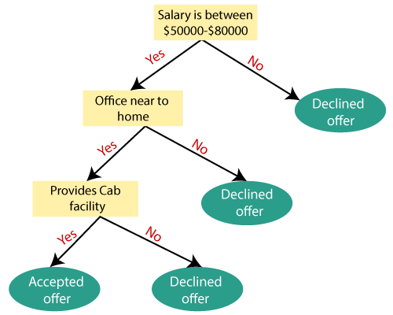
Example: Suppose there is a candidate who has a job offer and wants to decide whether he should accept the offer or Not. So, to solve this problem, the decision tree starts with the root node (Salary attribute by ASM). The root node splits further into the next decision node (distance from the office) and one leaf node based on the corresponding labels. The next decision node further gets split into one decision node (Cab facility) and one leaf node. Finally, the decision node splits into two leaf nodes (Accepted offers and Declined offer). Consider the below diagram:

Slide 5
Advantages of the Decision Tree:--
1) It is simple to understand as it follows the same process which a human follow while making any decision in real-life.
2)It can be very useful for solving decision-related problems.
3)It helps to think about all the possible outcomes for a problem.
Disadvantages of the Decision Tree:--
1)The decision tree contains lots of layers, which makes it complex.
2)It may have an overfitting issue, which can be resolved using the Random Forest algorithm.
3)For more class labels, the computational complexity of the decision tree may increase.

Slide 6
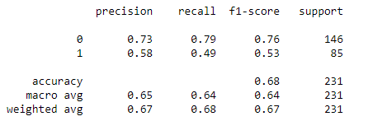
Work implementation of decision tree:-
After applying decision tree technique with the PIMA Indian dataset we get the value of True positive=115, True negative=42,False positive=31, False negative=43.
The decision tree classifier’s shows the accuracy level of nearly 67%, more precisely 0.6796536796536796 which indicates that the performance of these techniques are pretty well.
Classification report of decision tree------>
https://ssl.gstatic.com/docs/common/profile/material_unverified_user_96.svg

Slide 7
THANK YOU

